Slide 1
Marketing CRM and Collaboration Software Evaluation and Analysis
Evaluation for Lupa Solutions
Prepared by Consultant, Al Leong, MBA (604) 781 4470
Phase 1: Initial Evaluation List, Short list approach review.

Slide 2
Evaluation Methodology
Requirements
Features
Budget
Preliminary Assessment
Top 40 Universe List for consideration
Shortlist using Gartner Group Magic Quadrant overlay for Lupa Solutions’ specific needs
Pre-evaluate top 5 applications
Weight-factor scoring and ranking

Slide 3
Requirements
Features:
List Given for Must Have/ Wants
TBD – waiting for Matthew Dundon/team feedback.
For use with Lupa’s clients with respect to their customers (B2C)
Content management, email marketing, analytics, contacts and sales management
Budget:
$30,000 USD/year; Total Cost of Ownership to be $50-60k/year; prefer less
Equivalent to $2,500/month for all users/seats

Slide 4
Top 42 Applications (Long list)
Act!
Aptean
Base CRM
blueCamroo
Bpm online
C2CRM
Campaigner
Claritysoft
ClickHQ
Commence
Goldmine
Gold-vision
Highrise
Hubspot
Info CRM
InfoFlo
Infusionsoft
Insightly
Leadmaster
Maximizer
Microsoft Dynamics
Netsuite CRM+
Nimble
Nutshell
OnContact
Oracle CRM OnDemand
Pegasystems
Pipedrive
PipelineDeals
Pipeliner
Prophet
Sage CRM
Salesforce Sales Cloud
Salesnet
Salesnexus
SAP
Soffront
SugarCRM
Work[etc]
Workbooks
ZohoCRM
Zendesk

Slide 5
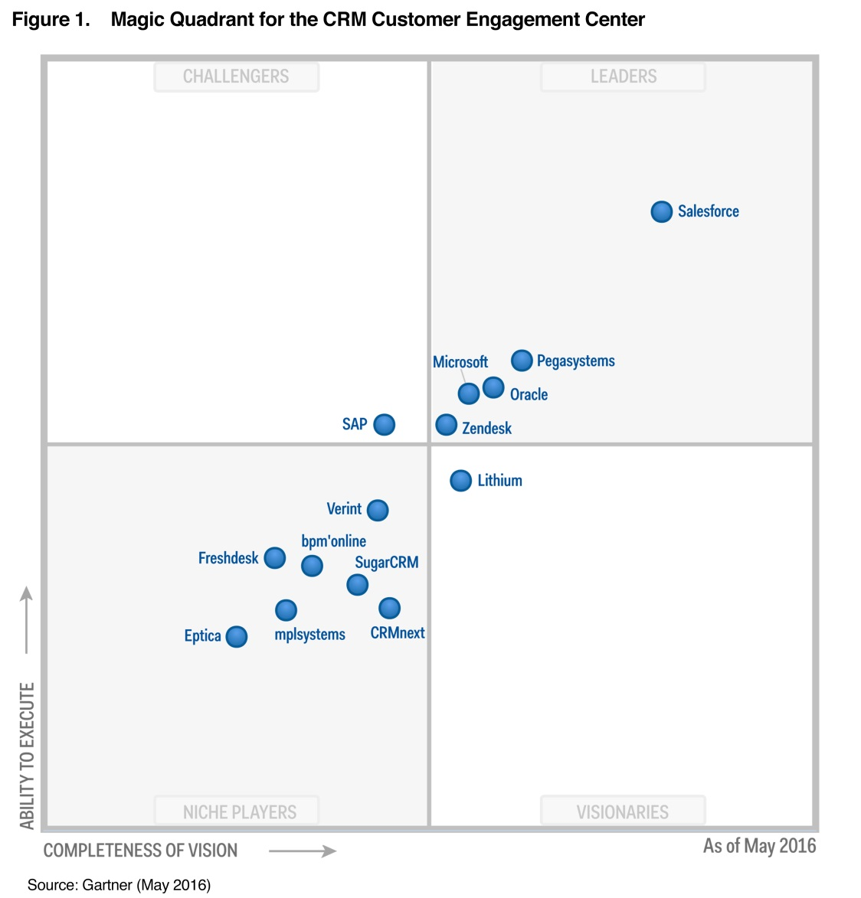
Shortlist: Leaders, Challengers
Leaders: Most trusted, capable, innovative
Challengers: challenge for leadership
Visionaries – great vision but does not fully execute
Niche Players – value, specific focus but lacks full breath/depth of vision and execution

Slide 6
Shortlist
Based on budget, all top 40 applications remain viable with most apps costing between $25-75/mo/user. At the top end, ($/mo/user; +10 user cost): (red within Gartner MQ)
Hubspot (free) $200/mo-800/mo $24,000/year
Pegasystems $200/mo/user $24,000/year
Infusionsoft $199/mo/user $23,880/year
Netsuite CRM $129/mo/user $15,480/year
Salesforce w/Mobile $125/mo/user $15,000/year
Salesforce $75-300/mo/user $9,000/year
Oracle CRM OnDemand $75/mo/user $9,000/year
Microsoft Dynamics $65/mo/user $7,800/year
SugarCRM $65/mo/user $7,800/year
Zendesk $49/mo/user $5,880/year

Slide 7
Recommendation For Features Weight-Factor Analysis
Performance leadership, extensibility for future needs, features, integration (w/requirement to spend less)
#1 - Salesforce $75-125/mo/user
#2 - Oracle CRM On Demand $75/mo/user
Value, less robust, but still a leading product
#3 - Zendesk $49/mo/user
Niche product for
#4 SugarCRM $65/mo within Gartner Niche players
Lowest Cost Option
#5 BPMonline $25/mo within Gartner Niche players

Slide 8
Features Analysis
Features “Must Haves” (9-10)
Reports & Dashboards
Mobile CRM, mobile apps and alerts
Email client integration (outlook, gmail)
Workflow and approvals
Role based views
Collaboration software integration
“Wants” (6-8)
Sales data, file storage, sync, share
Partner management
Contact management
Sales team and customer opportunity management
Sales analytics
Sales collaboration
Others (0-5)

Slide 9
Results
“Must Haves”
#1 Salesforce
#2 Oracle
#3 SugarCRM
Only 3 apps met all 6 must- have require- ments.

Slide 10
Results
Overall Score and Ranking

Slide 11
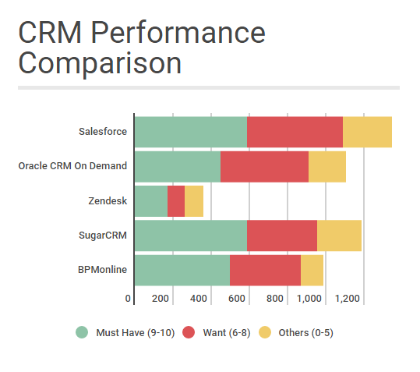

Slide 12
Performance vs. Value
Performance
Value

Slide 13
Recommendations (given Lupa’s requirements, preferences, budget)
Go for performance – Choose Salesforce
This is the Sports Car / Mercedes AMG
Go for economy/value – Choose SugarCRM
Toyota or Honda
Go something in-between – Choose Oracle

